Slide 1
HOUSEHOLD INCOME, DISTRICT FUNDING, & SAT / ACT PERFORMANCE
Project 1 : Rebecca Liu jiayu
Notes:
I will be presenting on income, school funding, and its influence on SAT and ACT performance.

Slide 2
The Problem Statement
You are hired by the state of California to analyze standardized test performance for various districts in the state and identify trends so they can allocate resources appropriately, and hopefully enable more students to go to college.
Identify the districts in California that have the worst overall student performance on the SAT and ACT tests
Identify possible reasons for the performance gap between these districts and the best performing districts.
Identify potential reasons for poor participation rate in the SAT and ACT.
Notes:
I’m posing as someone hired by the state of California. My aim is to → read bullet points → so that the department of education can allocate resources appropriately, and hopefully enable more students to go to college.

Slide 3
The Background
Richer students do better on the SAT and ACT!
Reasons often cited: (1) ability to pay for private test prep courses (2) students living in wealthier districts typically attend better-funded schools.
This study thus investigates how strongly school funding and student household income influences SAT and ACT scores, as well as test participation rates.
Notes:
A brief look at the literature seems to suggest that household income is a major predictor of SAT and ACT scores, with richer students outperforming poorer students.
Reasons often cited this include ability to pay for private test prep courses, and the fact that students living in wealthier districts typically attend better-funded schools. However, research seems to indicate that private test prep actually has limited effect on test grades.
This study thus aims to investigate how strongly school funding and student income influences test performance and participation rates.

Slide 4
The Dataset
2019 ACT Scores in California by School (California Department of Education)
2019 SAT Scores in California by School (California Department of Education)
2019 Most and Least Equitable School Districts in California
Extracted from: (wallethub.com)
Figures are drawn from the 2019 Census
Notes:
I used the two California datasets provided, but also added an external dataset drawn from the 2019 Census.

Slide 5
The Variables
The following variables are recorded on the school district level:
Average household income
Public expenditure per student
Performance on SAT test – measured by percentage of students scoring over the mean
Evidence-Based Reading and Writing
Mathematics
Composite score
Performance on ACT test
Average Reading score
Average English score
Average Mathematics score
Average Science score
Composite score – measured by percentage of students scoring over the mean
Participation rates – measured by percentage of enrolled seniors who took the SAT / ACT
Notes:
From these datasets, I pulled these variables. We basically have student income and funding data, test score indicators, and participation rates.

Slide 6
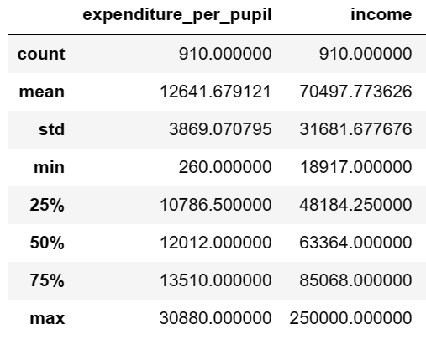
Descriptive Stats (Income & Funding)
Notes:
After merging the datasets and excluding outliers, there was expenditure and income data for 910 school districts.

Slide 7
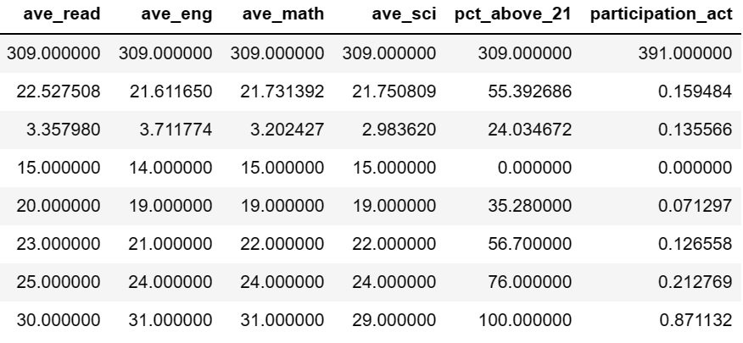
Descriptive Stats (ACT Scores)
Notes:
However, there were only 300 valid data points on test scores due to a low overall participation rates of 15%. However, participation rate and test performance fluctuated pretty widely across districts. If the mean is a passing grade, there were districts in which everyone passed, and districts where NOBODY passed.

Slide 8
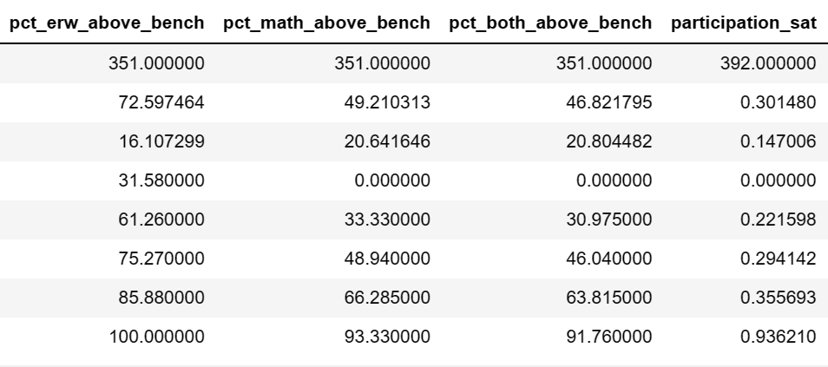
Descriptive Stats (SAT Scores)
Notes:
Same for the SAT. Slightly higher participation rate, 30%, but with wide fluctuations in participation and scores.

Slide 9
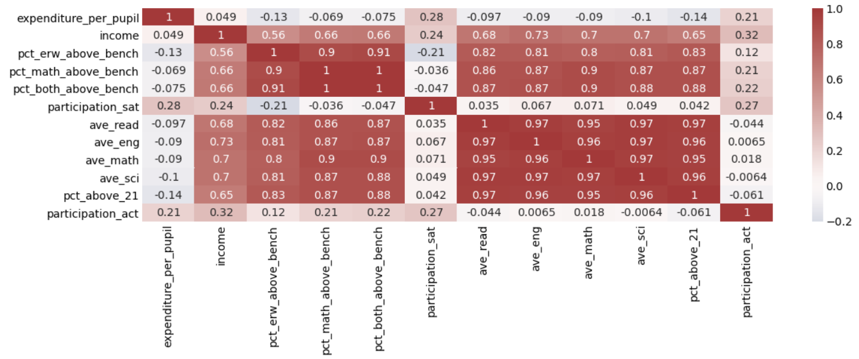
Correlations
Red shows a positive relationship and blue shows a negative relationship!
Notes:
So, correlations.
Red values represent positive correlations, and blue represents negative correlations. Color intensity represents the intensity of the relationship.

Slide 10
Correlations
Red shows a positive relationship and blue shows a negative relationship!
Notes:
First, I’m going to cover these up. They are neither relevant nor meaningful.

Slide 11
Finding 1:
Districts with high SAT scores are extremely likely to have high ACT scores too!
Notes:
Our first finding is that districts with high SAT scores tended to have high ACT scores too! You can see these parts are VERY red, which basically shows a high effect size. If you did well on one test, you’ll probably do well on the other.

Slide 12
Finding 2:
The strongest predictor of test performance is household income!
Notes:
Our second, more interesting finding is that household income is our next strongest predictor of test performance!

Slide 13
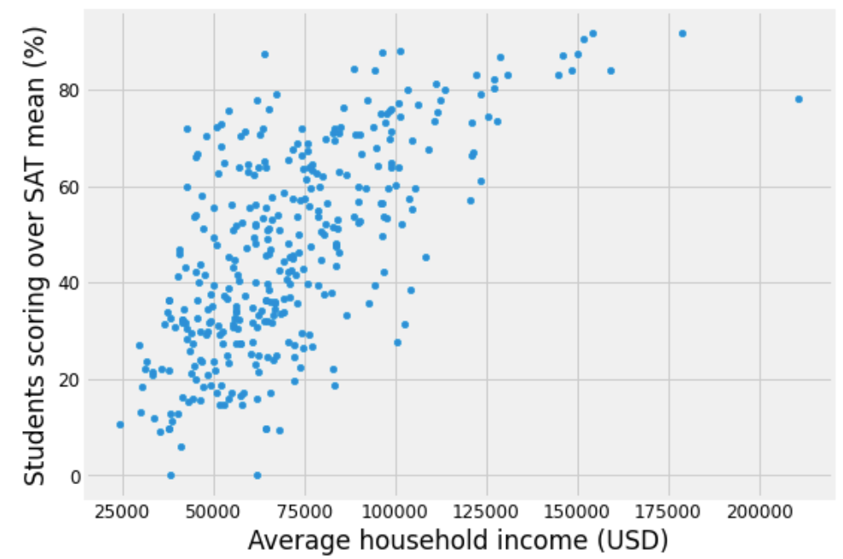
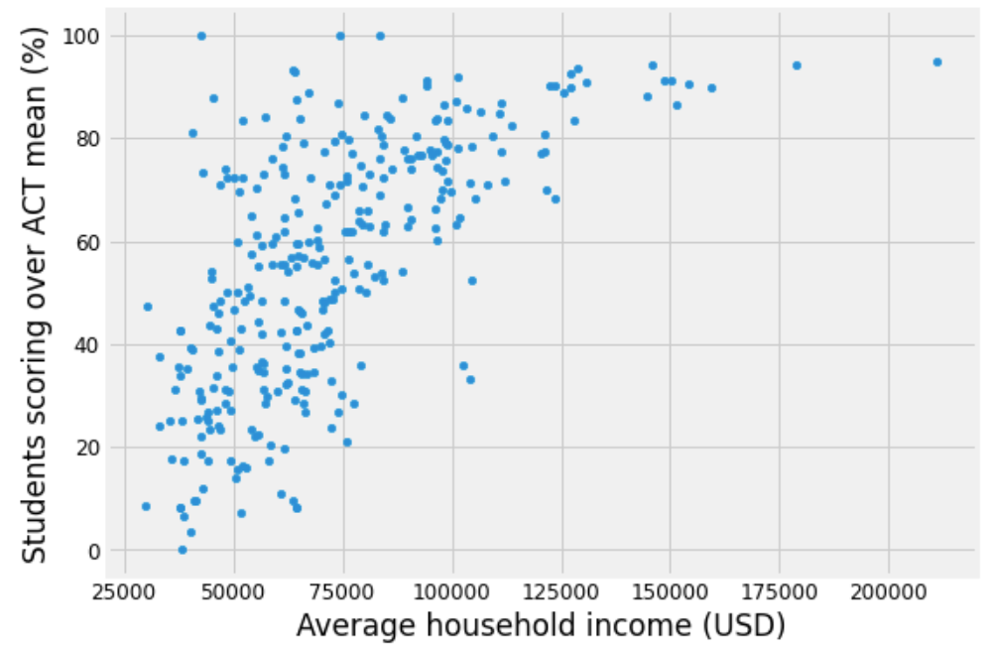
Finding 2:
The strongest predictor of test performance is household income!
SAT Scores
ACT Scores
This held for both the SAT and ACT -- it doesn't appear that one is more "equitable" than the other!
Notes:
You can see a strong positive correlation on both tests. The effect sizes were very similar for both, which suggests that one test isn’t more equitable than the other. Both tests are. Equally bad.

Slide 14
Finding 3:
It’s untrue that schools are better funded in districts with high average incomes!
Notes:
So, one of the commonly cited reasons for the income-score gap is that schools are better funded in wealthier districts…
But, that actually seems to be untrue. Funding is very weakly correlated to income.

Slide 15
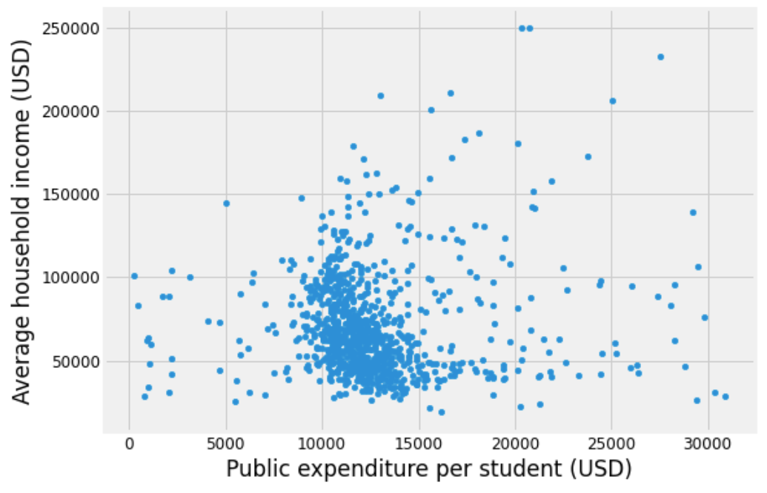
Finding 3:
It’s untrue that schools are better funded in districts with high average incomes!
There is little correlation between expenditure per student and average household income.
Notes:
Scatter plot is just a blob with no real shape.

Slide 16
Finding 4:
Districts that were better-funded performed more poorly!
Notes:
In fact, districts that were better funded actually performed more poorly! If you look at the relevant cells, you can see that they are faintly blue, which represents a small negative relationship.

Slide 17
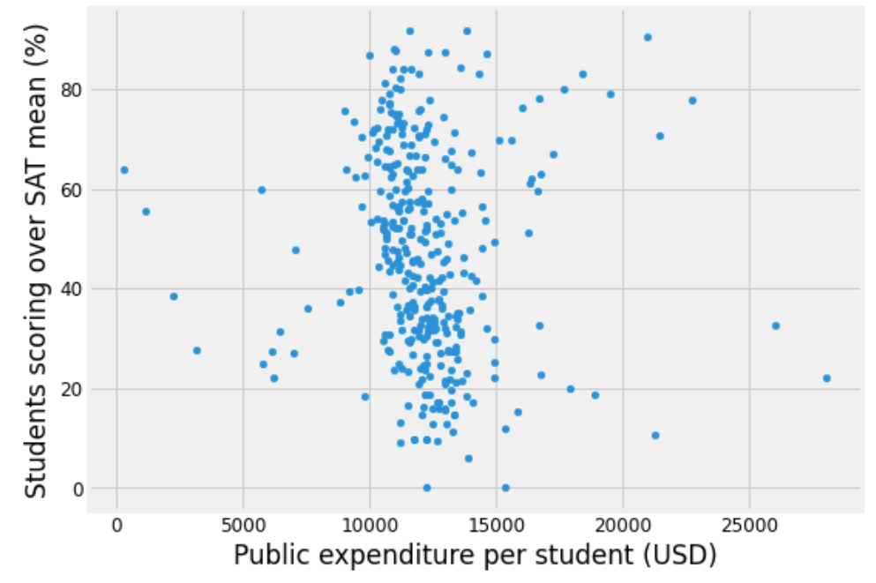
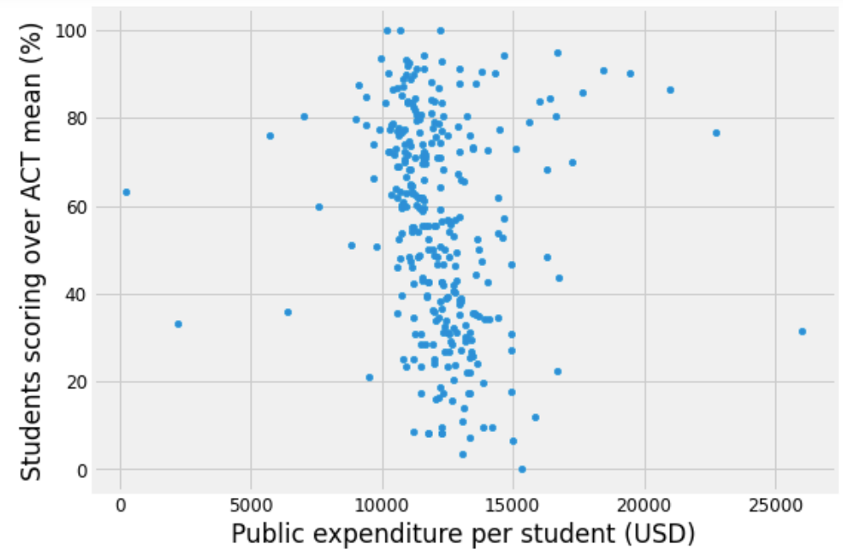
Finding 4:
Districts that were better-funded performed more poorly!
SAT Scores
ACT Scores
Test performance and funding was very weakly correlated, and the correlation was negative.
Notes:
However, on scatter plot, the relationship seem to be strongest in the middle there. But there are these small ones around it that throws the correlation coefficient off. We’ll revisit this later, but for now…

Slide 18
Finding 5:
Better test performance is not really associated with better participation rates
Notes:
Let’s move on to participation rates. I kinda expected that maybe people won’t participate if they think they won’t do well on the test, but that doesn’t seem to be the case. Better test performance was not consistently associated with higher participation rates.

Slide 19
Finding 6:
But household income and funding seemed to increase test participation rates!
Notes:
HOWEVER, household income and funding DO have a moderately positive effect on participation rates!

Slide 20
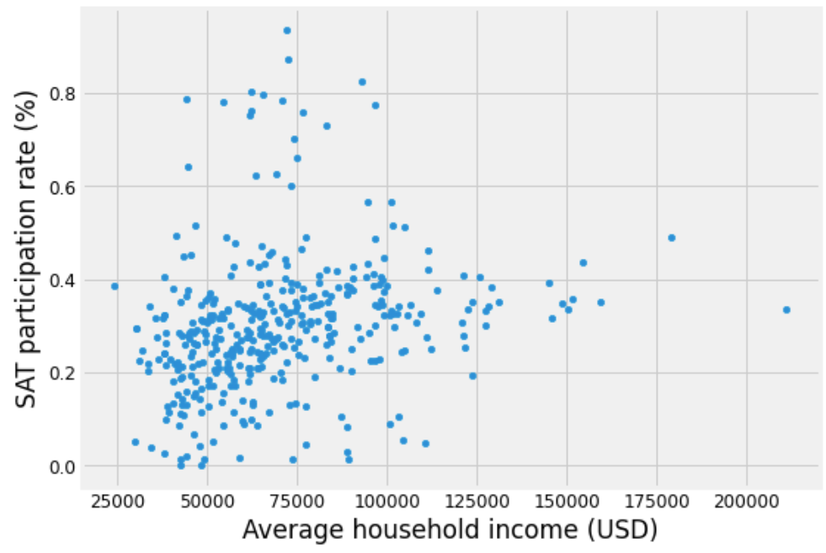
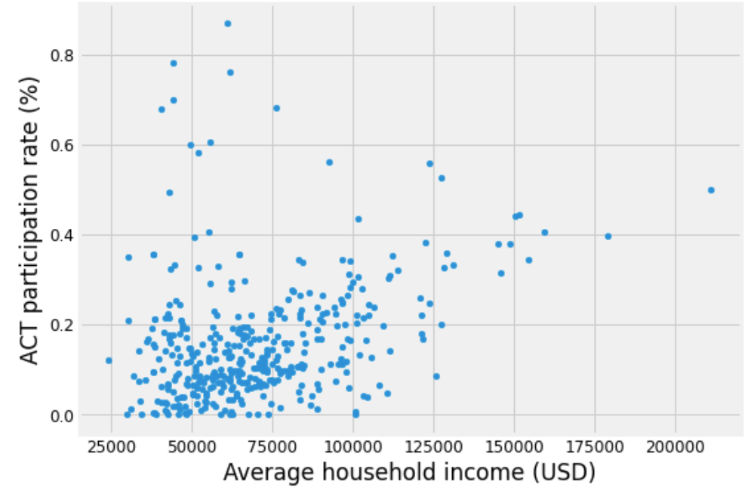
Finding 6a:
But household income and funding seemed to increase test participation rates!
SAT Participation
ACT Participation
Higher household income was moderately associated with higher test participation.
Notes:
Here you can see that (read bottom caption)

Slide 21
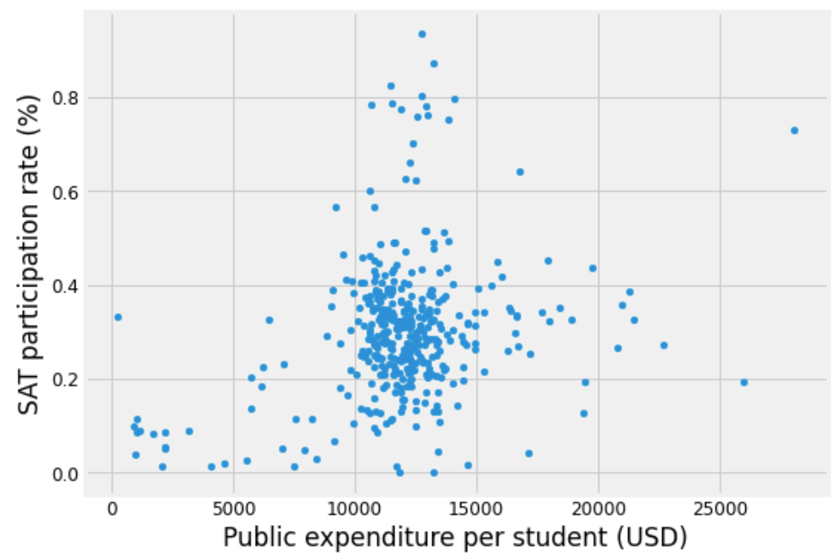
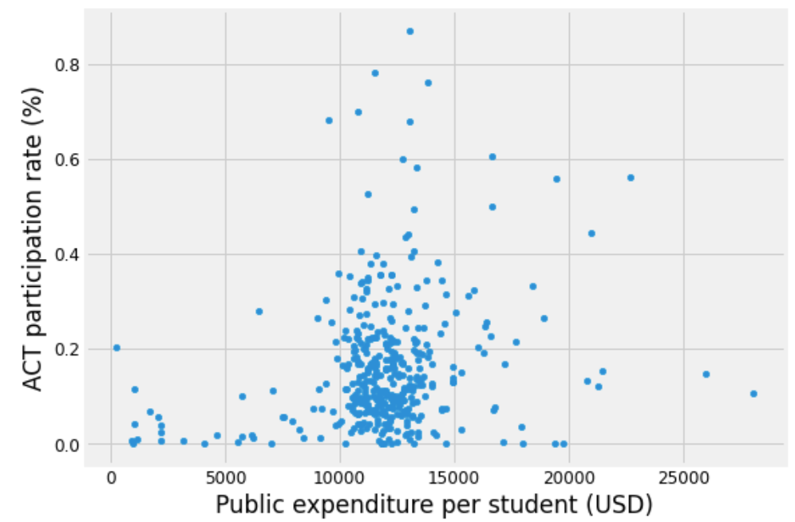
Finding 6a:
But household income and funding seemed to increase test participation rates!
SAT Participation
ACT Participation
Funding moderately increased test participation rates for both tests!
Notes:
And here you can see that (read bottom caption)

Slide 22
Findings:
A summary of the key takeaways!
Districts with high SAT scores are extremely likely to have high ACT scores as well
The strongest predictor of test performance was household income
However, it's untrue that schools are better funded in districts with high average incomes
In fact, districts that were better-funded performed more poorly!
Funding is going into inefficient programs?
OR
Funding is allocated based on district’s overall test performance?
Improving test performance will not necessarily increase participation rates
However, higher household income and district funding seemed to moderately increase test participation rates!
Notes:
So to summarize the main findings:
Districts with high SAT scores are extremely likely to have high ACT scores as well.
The next strongest predictor of test performance was household income
However, contrary to expectation, this is not because schools are better funded in districts with high average incomes
In fact, districts that were better-funded seemed to perform more poorly
On one hand, this could suggest that funds are being poured into inefficient programs.
On the other, funding might actually be allocated such that poorly-performing districts get more funding.
Time series data would probably be needed to rule out or confirm these explanation.
If participation rates are a concern, improving test performance will not necessarily increase participation rates.
However, higher household income and district funding seemed to moderately increase test participation rates!

Slide 23
Recommendations:
Time series data should be collected to properly investigate the long-term effect of district funding on test performance
Data should be collected to estimate the efficiency of ongoing or potential programs
More research should be done to figure out exactly what explains the relationship between income and test performance
If participation is a concern, increasing funding for a district might help!
But in the short-run, the heavy use of SAT and ACT scores in the college admission process will only reinforce income inequality!
Encourage universities to adopt affirmative action policies based on family income?
Encourage universities to adopt alternative ways of assessing candidates?
Notes:
Time series data should be collected to properly investigate the long-term effect of district funding on test performance
Data should be collected to estimate the efficiency of ongoing or potential programs: This can be collected from schools in California, or by exploring the literature on interventions being implemented outside of California. This would help us invest funds more effectively.
However, more research should be done to figure out exactly what explains the relationship between income and test performance: Qualitative research such as observing the school and home environments of students may enable us to better investigate this relationship.
RE participation rates, if we wanted to increase participation rates, increasing funding for a district MIGHT work…
BUT in the short-run, the heavy use of these tests in college admissions will only reinforce income inequality: So until more can be done to lessen the income-score gap, temporary measures should be established to enable more poorer students to enter universities. This could include:
Encouraging universities to adopt affirmative action policies based on family income
Encouraging universities to adopt alternative ways of assessing candidates. An increasing number of universities are making submission of SAT or ACT scores option and are assessing candidates based on testimonials or personal statements. However, it should be noted that such methods of assessing candidates may not necessarily be more equitable than using standardized testing. More research is needed.

Slide 24
THANK YOU!
Project 1 : Rebecca Liu jiayu

